Slide 1


Slide 2
Database Management Systems
Week 7, Day 4
MongoDB—Geospatial Databases
Atta Muhammad
+92-333-1971110
attapanhyar@quest.edu.pk

Slide 3
Download Sample Database
Download the example datasets from
Neighbourhoods:
https://raw.githubusercontent.com/mongodb/docs-assets/geospatial/neighborhoods.json
Restaurants:
https://raw.githubusercontent.com/mongodb/docs-assets/geospatial/restaurants.json

Slide 4
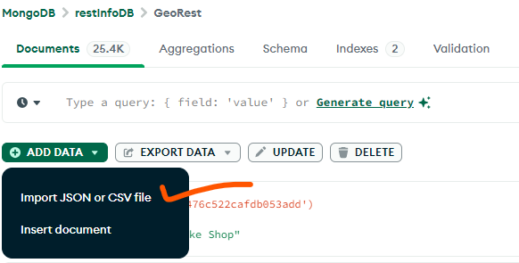
Import Collections

Slide 5
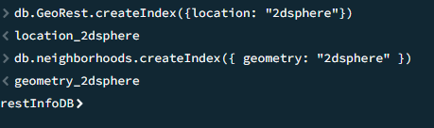
Create Indexes
A geospatial index, and almost always improves performance of $geoWithin and $geoIntersects queries.

Slide 6
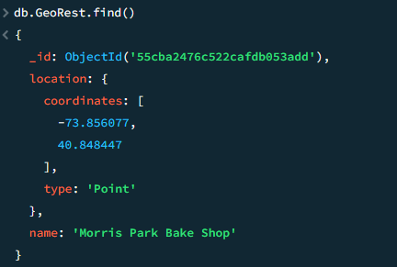
Exploring the Data
Inspect an entry in the newly-created GeoRest collection in mongosh:

Slide 7
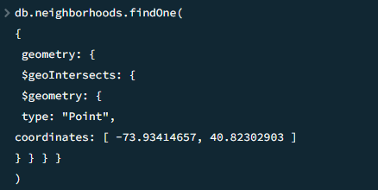
Current Neighborhood
Suppose the user is located at -73.93414657 longitude and 40.82302903 latitude. To find the current neighborhood, you will specify a point using the special $geometry field in GeoJSON format

Slide 8
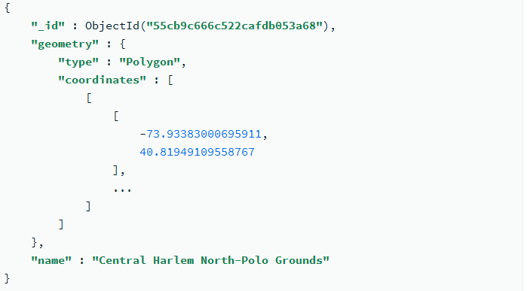
Output

Slide 9
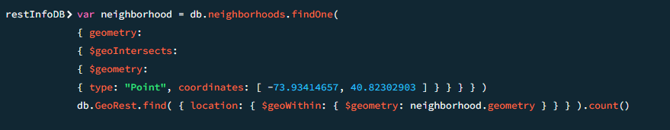
Find all Restaurants in the Neighborhood
You can also query to find all restaurants contained in a given neighborhood (127)

Slide 10
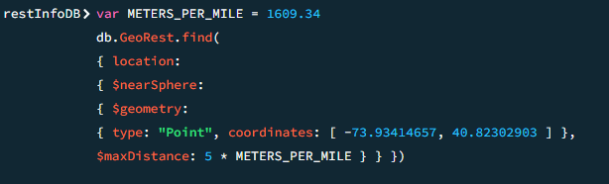
Find Restaurants within a Distance

Slide 11
Question(s)

